Slide 1
Residential Management System
Harry Seong
CIS 212
8.9.2016

Slide 2
What does it do? A bird’s eye view…
Creates 14 unique [Dorm] objects.
[Dorm] objects each create a set number of [Room] objects.
Creates 3 [MealPlan] objects.
Creates inputted number of [Student] objects.
Assigns each [Student] object to [Dorm] & [Room] object.
Assigns a [MealPlan] object to each [Student] object.
Displays/creates reports.

Slide 3
UML for Classes
Student | Dorm | Room | MealPlan
-dorm:Dorm -room:Room -mealPlan:MealPlan -firstName:String -lastName:String -studentID:int -netID:String -gradeYear:String -emailAddress:String -phoneNumber:String -major:String | -rooms:ArrayList<Room> -occupiedRooms:ArrayList<Room> -dormName:String -streetNumberName:String -city:String -state:String -zipCode:String -numberOfFloors:int -numberOfRooms:int -housingCostPerRoom:int -noVacancies:Boolean | -occupant: Student -occupied: boolean -roomNumber: int | -mealPlanName: String -boardMealsPerQtr: int -wildCatPointsPerQtr: int
+Student(firstName:String, lastName:String, studentID:int, gradeYear:String, emailAddress:String, phoneNumber:String, major:String) : +assignDorm(dorm:Dorm) : void +assignRoom(room:Room) : void +assignMealPlan(mealPlan:MealPlan) : void +getStudentName() : String +getStudentID() : String +getStudentRoomNumber() : String +getStudentInfo() : void +getStudentInfo(outputFile:PrintWriter) : void | +Dorm(dormName:String, streetNumberName:String, city:String, state:String, zipCode:String, numberOfFloor:int, numberOfRooms:int, housingCostPerRoom:int) : +prepareRooms() : void +updateOccupatedRoomList(room:Room) : void +updateOccupancy() : void +getVacancyStatus() : Boolean +getRooms() : ArrayList<Room> +getDorms() : String +getNumberOfOccupiedRooms() : int +getNumberOfRooms() : int +getDormOccupants() : void +getDormOccupants(outputFile:PrintWriter) : void +getDormInfo() : void +getDormInfo(outputFile:PrintWriter) : void | +Room(roomNumber:int) : +Room(roomNumber:int, occupant:Student, occupied:boolean) : +assignToRoom(occupant:Student) : void +getRoomNumber() : int +getOccupant() : Student +checkOccupancy() : boolean | +MealPlan() : +MealPlan(plan:String) : +getMealPlanName() : String +getBoardMealsPerQtr() : int +getWildCatPointsPerQtr() : int +getMealPlanInfo() : void +getMealPlanInfo(outputFile:PrintWriter) : void

Slide 4
UML Diagram
Dorm 1
ArrayList<Room>
Dorm 2
ArrayList<Room>
Room 303
Room 101
Room 102
Student 1
Student 2
Student 3
Room 304
Student 4
Student 1
Dorm 1
Room 101
MealPlan A
Student 3
Dorm 2
Room 303
MealPlan B

Slide 5
Code Review

Slide 6
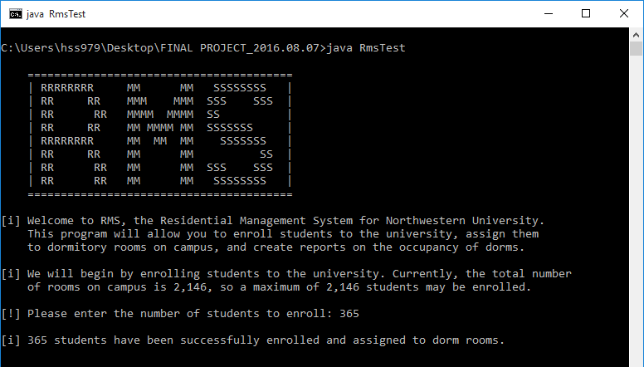
Program: Introduction

Slide 7
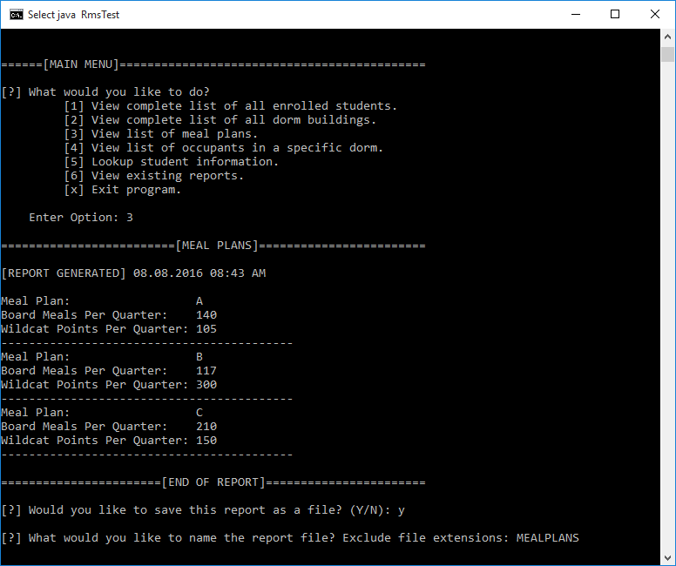
Program: Main Menu

Slide 8
Program: Demonstration

